Slide 1
Introduction

Slide 2
Agenda
Teacher introduction
What is the course about
The architecture of wearable IoT systems
Applications of wearable IoT in healthcare and wellbeing
Course program
The exam & The project
Appendix: Data source characteristics

Slide 3
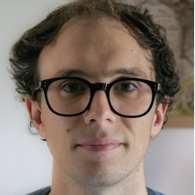
Who am I
Giacomo Cappon
Assistant Professor, Department of Information Engineering, University of Padova
PhD in Information Engineering, curriculum Bioengineering
Main research interests: signal processing; decision support systems; wearable sensors; digital health; ai for medicine
Contacts
email: giacomo.cappon@unipd.it
personal website: https://gcappon.github.io
public repos: https://github.com/gcappon

Slide 4
What is the course about?
Biomedical wearable technologies…
E-health
E-health or digital health: The use of modern Information and Communication Technologies (ICT) to efficiently deliver all kinds of healthcare services
Examples: EHR, telemedicine systems
Wearables: electronic devices worn close to and/or on the surface of the skin, which detect, analyze and transmit biomedical data, such as heart rate, activity, blood pressure, temperature, etc.
Internet-of-thing (IoT) wearables: Wearables that connect and exchange data with other devices (wearable or not) and systems over the Internet or other communication networks
Wearables
IoT wearables

Slide 5
What is the course about?
… for healthcare and wellbeing
Our society is facing some important global health challenges
Lifestyle-related illnesses driven by sedentary life, consumption of processed and fast foods, alcohol drinking and smoking
Need to change the paradigm of healthcare, from a mostly reactive system to a proactive system
Population ageing rises the demand of health services and the healthcare expenditure.
Need to decentralizing the healthcare
Covid-19 pandemic called for urgent delivery of healthcare at home
Biomedical wearable technologies are fundamental to make healthcare scalable and accessible outside the hospital setting and deliver personalized and preventive health services

Slide 6
Towards a new model of healthcare
Traditional healthcare system:
Reactive: focused on treating
Centralized: healthcare at hospitals
Population-based: maximizing health outcomes of a certain population
Doctor-centric: only doctor responsible for the patient's care
Biomedical wearable technologies play an important role in realizing a new model of healthcare which is:
Decentralized: healthcare at home to reduce pressure on hospitals
Proactive: focused on prevention
Personalized: maximising the health outcomes of single individuals
Participatory: engaging individuals in the healthcare process
Sustainable: better management of resources, patient prioritization

Slide 7
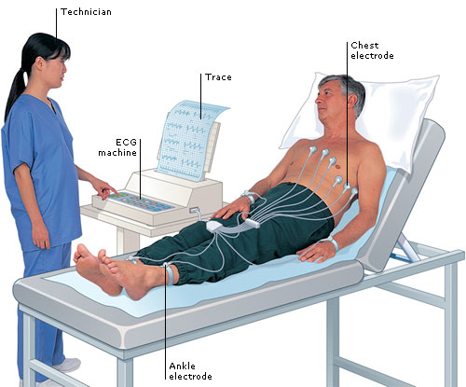
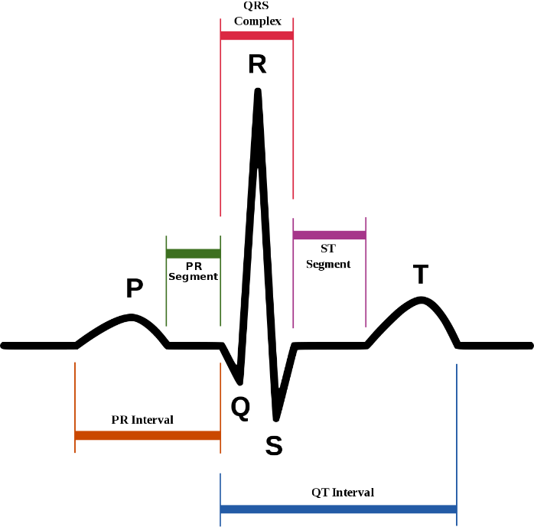
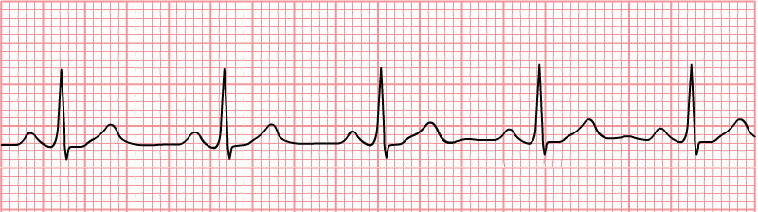
Examples of biomedical wearable technologies Heart rate monitor
Heart rate (HR): frequency of heart beats [beats/min]
Monitoring HR allows to detect bradycardia (slow HR), tachycardia (fast HR) or arrhythmia (irregular HR)
In hospital:
Electrocardiogram (ECG): electrical activity of the heart measured by on skin electrodes (usually 12)
HR determined as the frequency of peaks of the R wave

Slide 8
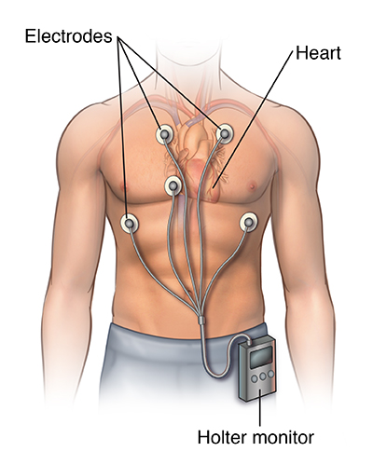
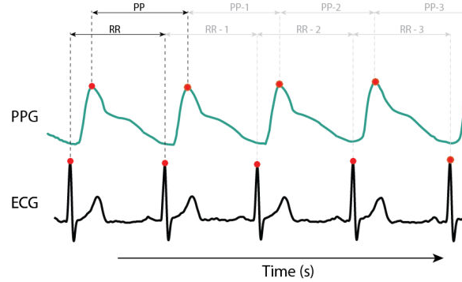
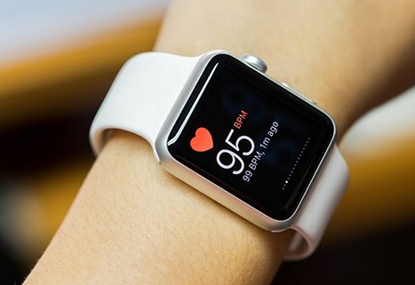
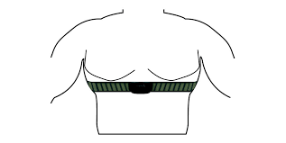
Examples of biomedical wearable technologies Heart rate monitor
Wearable HR monitors for home use:
Holter monitor: portable ECG monitor, 5 electrodes placed on the chest
Used for medical purpose
Low portability, used for 24-72 hours
Smartwatches use an optical sensor that shines light and measures changes in light absorpion to estimate changes in capillary blood volume
Resulting signal: photoplethysmogram (PPG)
HR estimated as the frequency of P waves
Chest straps: electrical activity of the heart measured with electrodes integrated in a chest band/strap

Slide 9
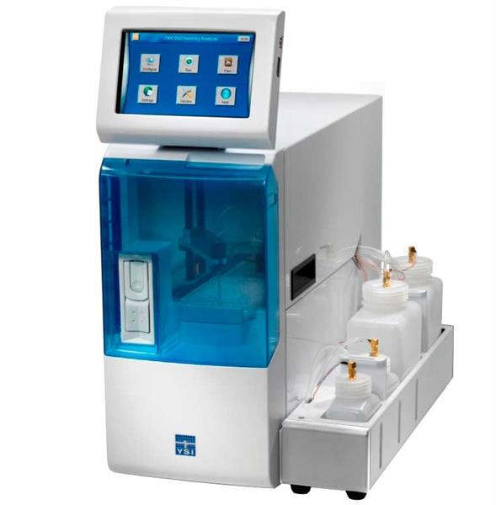
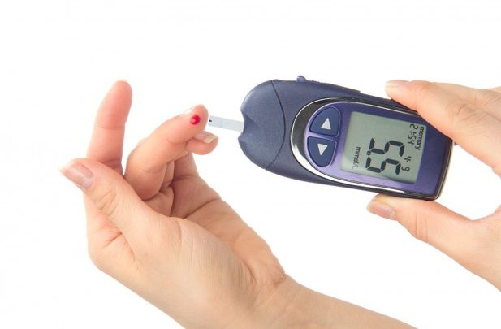
Examples of biomedical wearable technologies Glucose monitoring sensors
Blood glucose (BG) concentration: concentration of glucose in the blood [mg/dL or mmol/L]
Abnormal BG levels, e.g., hyperglycemia (too high BG) and hypoglycemia (too low BG), may occur in people with metabolism disorders (e.g., diabetes).
In hospital/laboratory:
Biochemistry analyzers
Exploit a chemical reaction driven by specific enzymes (e.g., glucose-oxidase)
Invasive (blood sample required), only sparse measurements possible
At home:
Self-monitoring of blood glucose (SMBG) or glucometer:
drop of capillary blood collected by fingerprick and put in a test strip
a portable glucose analyzer, through an electrochemical sensor, detects the BG concentration in the capillary blood
Minimally-invasive but not wearable: only sparse measurements possible (e.g., 3-4 per day)

Slide 10
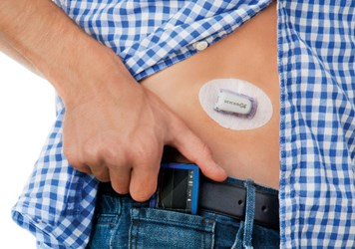
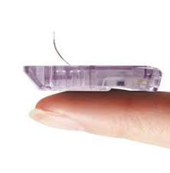
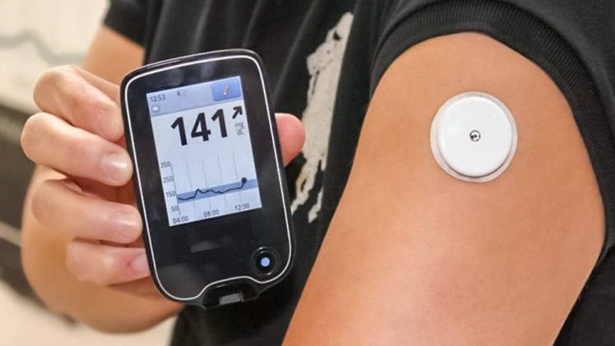
Examples of biomedical wearable technologies Glucose monitoring sensors
Continuous glucose monitoring (CGM) sensors
Minimally-invasive sensors measuring glucose concentration in the interstitial fluid at almost continuous time (e.g., every 5 min) for several consecutive days (e.g., 10 days)
Needle electrode placed under the skin, exploiting glucose oxidation reaction
The transmitter, placed over the electrode, wirelessly transfers the measured data to a portable display device
Mainly used in people with type 1 diabetes

Slide 11
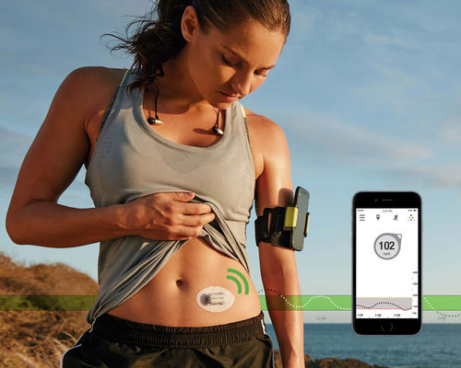
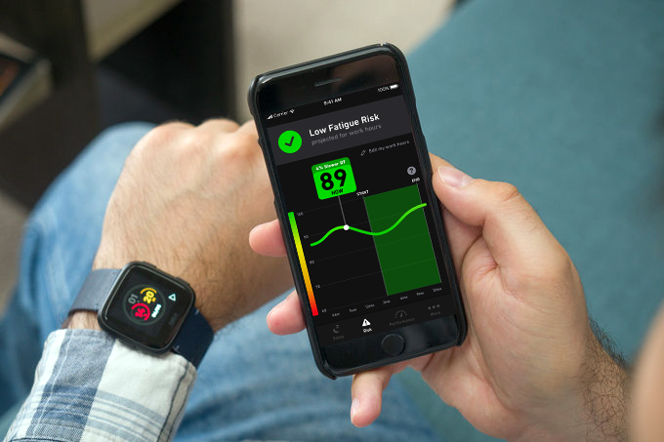
Modern wearable technologies become IoT
Modern wearable sensors can wirelessly connect to internet-connected devices, such as smartphones, by which the user can share their data with other people (e.g., doctor or family/friends) and upload them in the cloud

Slide 12


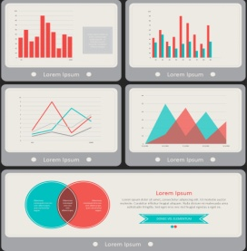
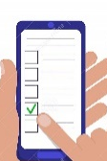
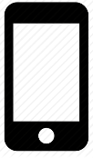
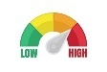
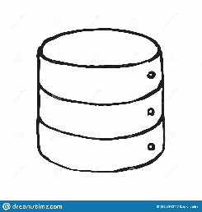

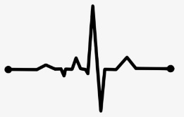
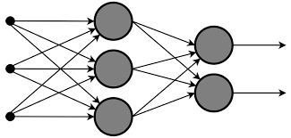
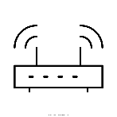
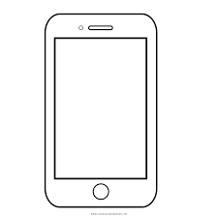
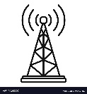
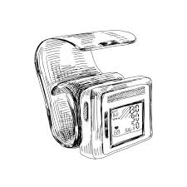
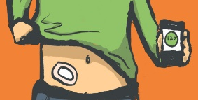
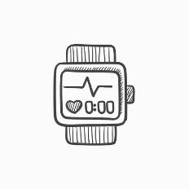
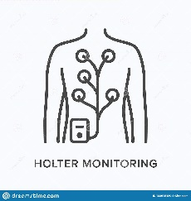
The architecture of wearable IoT systems
Alerts
Decision-support
Event log
Self-management
4. Application layer
Database
Data analyses
Signal processing
Modeling
3. Data storing and processing layer
Gateway device
WiFi,
Router
Internet
2. Network layer
GSM
Activity tracker
Sensors
ECG sensor
1. Sensing layer
Blood pressure sensor
Glucose sensor

Slide 13
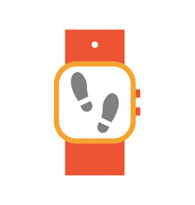
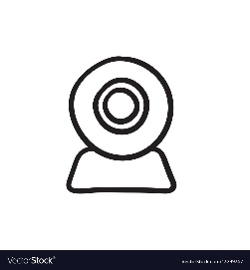
1. Sensing layer
This layer includes sensors, which are responsible for:
Collecting the data either directly from the body through contact sensors or from peripheral sensors providing indirect information of body and behaviours
Preparing the data for on-board analysis, closed-loop feedback or remote transmission for more comprehensive analysis and storing
Contact sensors
ECG sensor
Glucose sensor
Peripheral sensors
Step counter
Microphone and camera
Key components of IoT wearable sensors:
Miniaturized sensor hardware
Embedded processor with storage capabilities, power management and communication circuits
Typically limited computing power and storage capabilities.

Slide 14
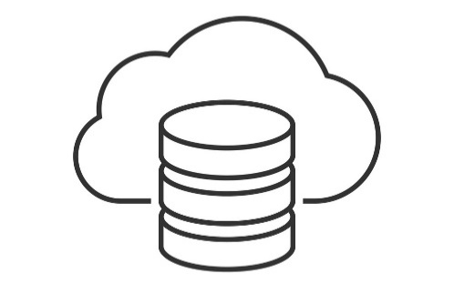
2. Network layer
Fore more comprehensive data analysis and storage, the sensor layer need to transmit the data to cloud computing servers (remotely-located computing machines).
This transmission can be mediated by a companion device that serves as a gateway, i.e., it enables the information to flow from sensors to the cloud server.
Example of gateway devices: smartphones, tablets and PCs.
The communication must be secured through:
Authentication protocols for writing, modifying and accessing the data
Security and privacy protocols for preserving the data
Sensor
Gateway device
Cloud server
Bluetooth
WiFi
GSM

Slide 15
3. Data storing and processing layer
Layer responsible for data storing and complex processing
Key components:
Database for structured data storing
Data organized based on a specific data model (relational, hierarchical, object-oriented,…)
Algorithms for data processing
Statistical analysis
Feature extraction (e.g., heart rate, calories expenditure, …)
Signal processing (e.g., filtering, artifact removal, …)
Data mining (e.g., cluster analysis, anomaly detection, sequential pattern extraction, …)
Data modeling (knowledge-based, data-driven or hybrid approaches)
Artificial intelligence (knowledge representation, machine learning, natural language processing, machine perception, automated planning, …)

Slide 16

3. Data storing and processing layer
Layer responsible for data storing and complex processing
Key components:
Database for structured data storing
Data organized based on a specific data model (relational, hierarchical, object-oriented,…)
Algorithms for data processing
Statistical analysis
Feature extraction (e.g., heart rate, calories expenditure, …)
Signal processing (e.g., filtering, artifact removal, …)
Data mining (e.g., cluster analysis, anomaly detection, sequential pattern extraction, …)
Data modeling (knowledge-based, data-driven or hybrid approaches)
Artificial intelligence (knowledge representation, machine learning, natural language processing, machine perception, automated planning, …)
Topic not covered

Slide 17
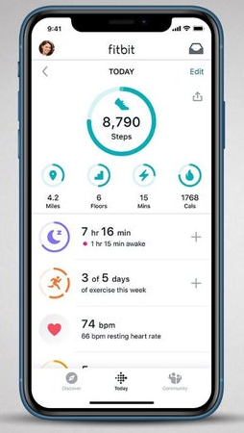
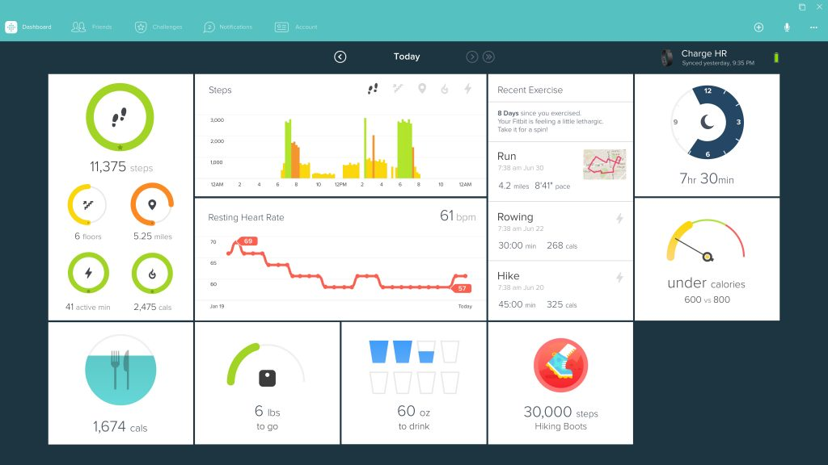
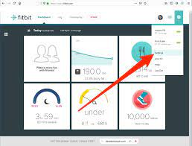
4. Application layer
Layer responsible for visualizing raw or processed data to end-users and for providing decision support to them through a software application
Possible end-users: patients, physicians, caregivers, analysts, data managers, administrators, etc.
Possible types of applications:
Mobile app
Desktop app
Web app
App that runs on the browser.
Installation not required. Internet access required.
App installed in a mobile device (e.g. smartphone, smartwatch, tablet, etc.)
App installed in a computer. It can work offline.

Slide 18
Applications of wearable IoT in healthcare and wellbeing
Some health applications:
Telemonitoring and telemedicine in chronic diseases
Investigative monitoring for diagnostic purposes
Sensor-based biomechanical telerehabilitation
Some wellbeing applications:
Sport and fitness sensing
Activity and sleep monitoring
Falls detection

Slide 19
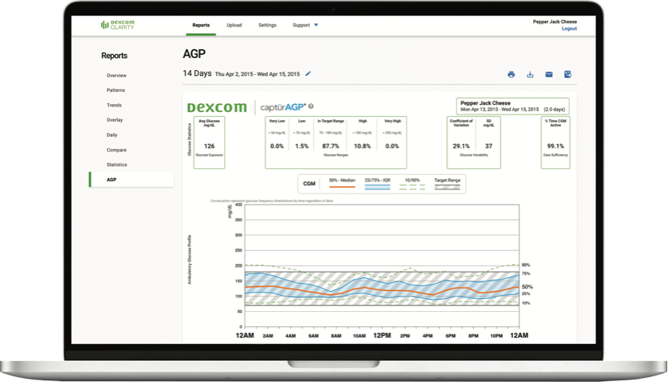
Telemonitoring and telemedicine in chronic diseases
Example: Telemonitoring of glucose concentration in people with diabetes
Through a dedicated telemonitoring application, the doctor can remotely review patients data at any time
Continuous data synchronization
Remote monitoring also possible for parents and caregivers

Slide 20
Investigative monitoring for diagnostic purpose
Monitoring of health parameters in outclinic context, for a limited period of time (e.g., few days) to detect a particular health condition that cannot be observed in clinic, to track the progress of a disease, or to monitor recovery from a specific health event.
Examples:
Professional CGM sensor: CGM provided to the patient for a short period (e.g., 7 days). Based on the collected data the doctor can adjust/optimize the patient’s therapy.
Holter and extended-holter systems: monitor HR for limited periods (e.g., 1-7 days) for detection of heart issues, e.g., cardiac arrhythmias
At-home sleep test for the diagnosis of obstructive sleep apnea (stops in breathing during sleep): monitoring of sleep at home for at least 1 night using wearable sensors provided by the doctor (breathing sensor, effort belt, pulse oximeter, and microphone)

Slide 21
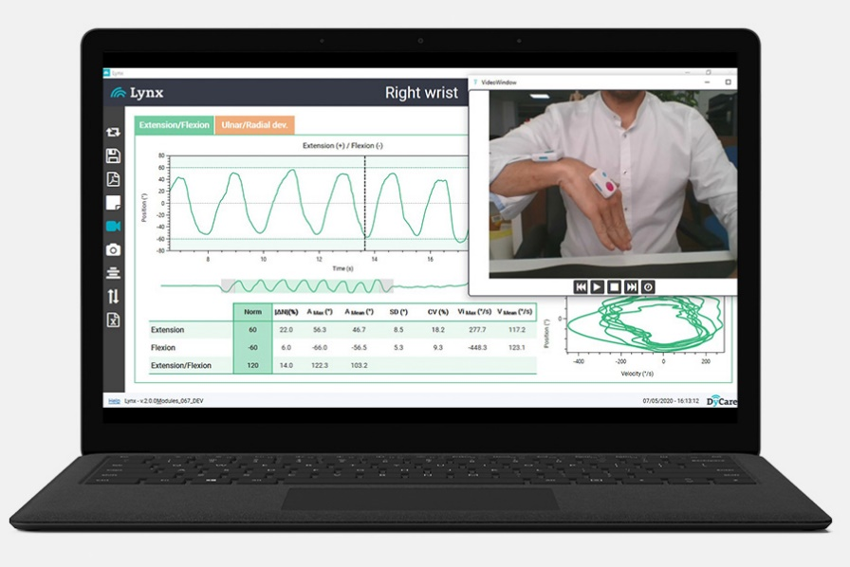
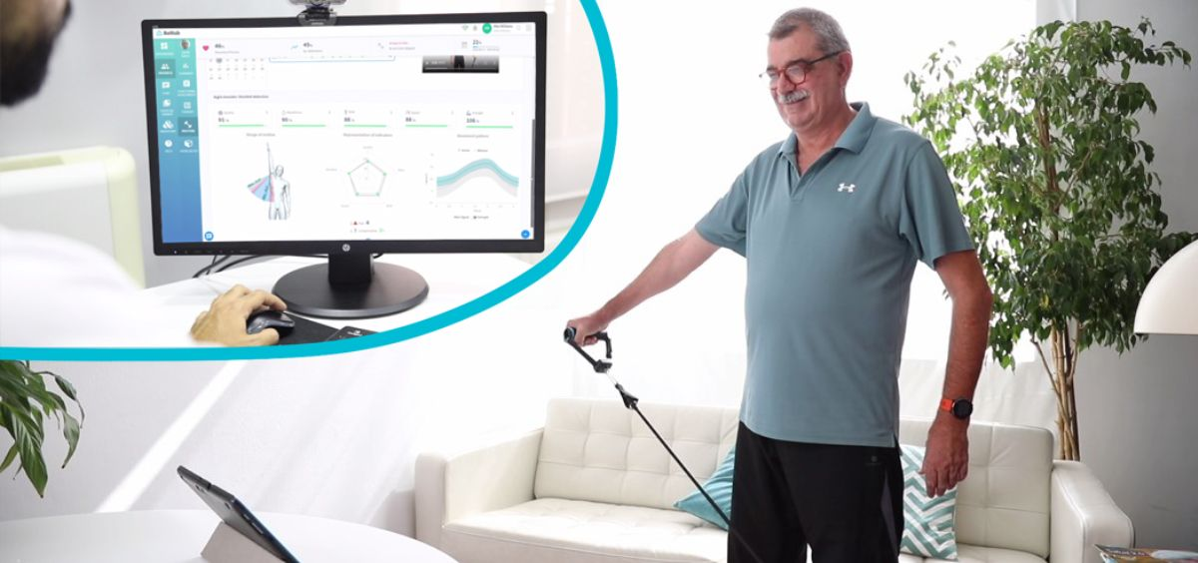
Sensor-based biomechanical telerehabilitation
Key components:
Wearable inertial sensors tracking patient’s movement
Interactive software
displays personalized rehabilitation exercises
receives the sensors’ data
provides the real-time representations of the patient
provides visual feedback to the patient, e.g. using an avatar
A platform for clinicians to remotely follow the therapy sessions in real-time or review the data offline
Main application: remote monitoring of patient performance and progress in a rehabilitation programs (e.g., post-stroke, post-fall, or post-surgical operation)

Slide 22
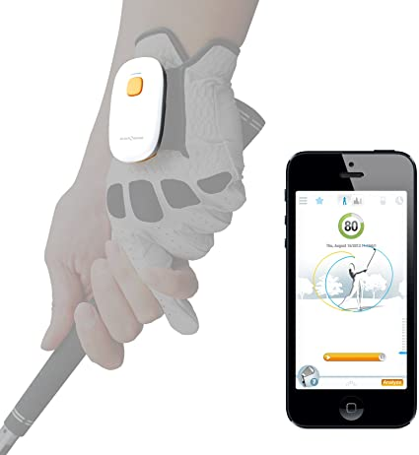
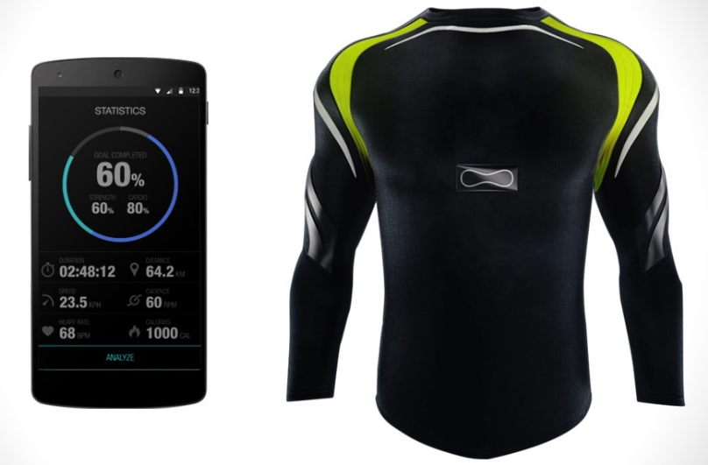
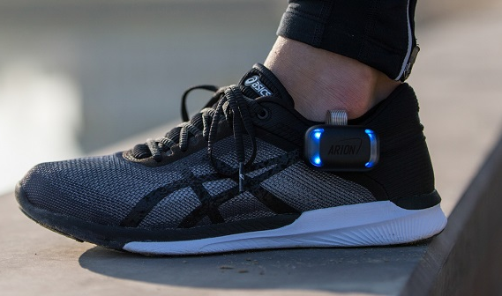
Sport and fitness sensing
Most common sensors: chest straps, wristbands, footpods and insoles, sensor patches, sensors in sportwear clothing (smart clothing), sensors in sportwear equipement
Real-time monitoring of performance and coaching through portable display devices
Off-line review of sport statistics, on web-based portals
Data sharing and social networking
Gamification of fitness data: gaming features (e.g. fitness challenges) encourage the adoption of fitness technologies.

Slide 23
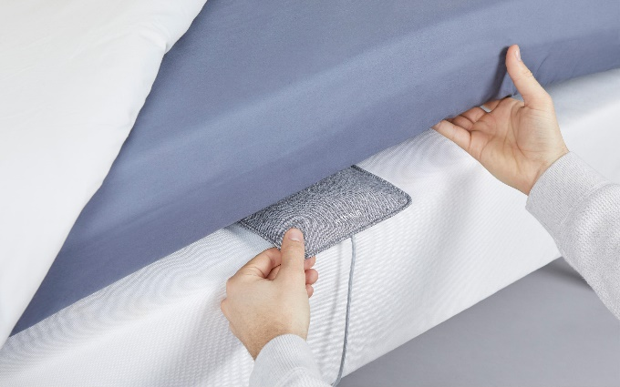
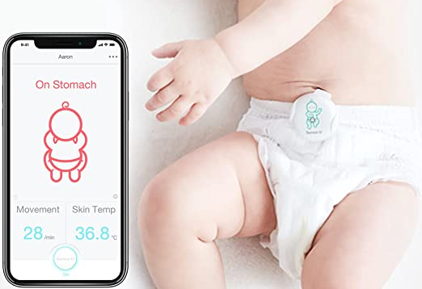
Activity and sleep monitoring
Measurements of activity (steps, distance traveled, etc.), calorie balance, sleep quality.
Objectives:
Encourage movement in sedentary individuals
Obesity management: monitor an individual’s participation in a weight management program and maintain engagement
Sleep monitoring by contact sensors (e.g. wristbands) or non-contact sensors (e.g. under-mattress sleep trackers)
Baby sleep monitoring sensors:
Inertial sensors monitor movement of the chest or stomach area
Built-in tactile stimulator triggered if no movement is detected for 15–20 seconds
If no movement detected after use of tactile stimulation, an alert is generated

Slide 24
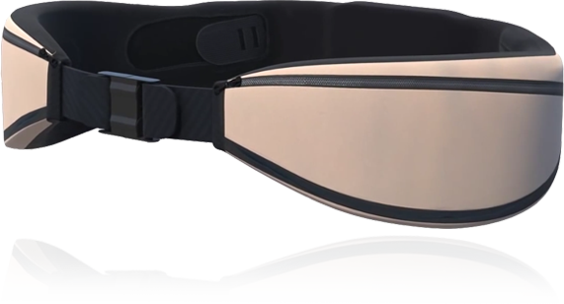
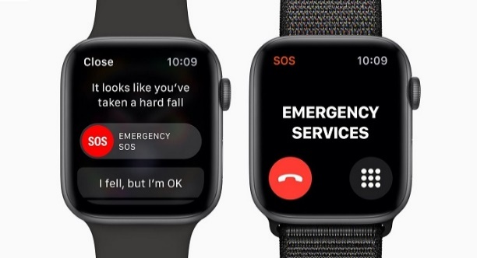
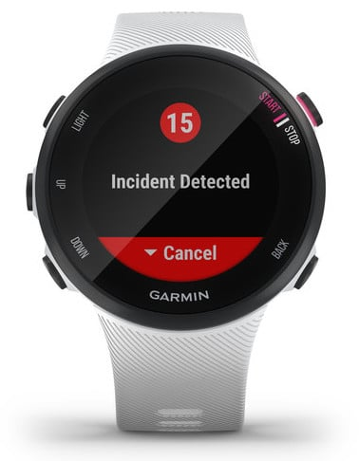
Fall detection
Falls-related injuries are the biggest cause of injury-related death in older adults
Fall detection devices:
Detection device based on inertial sensors worn on the wrist or waist or as a pendant.
An algorithm analyses movement measurements in real-time and sends an alert to an in-home base station if a fall is detected.
The in-home base station notifies a call center, which contacts the wearer.
If an emergency is determined or there is no response, the call center notifies the emergency services and alerts designated caregivers and family.
Also available in smartwatches used for sport sensing

Slide 25
The architecture of wearable IoT systems
In this course we will go through the four layers of wearable IoT systems starting from layer 1.
Alerts
Decision-support
Event log
Self-management
4. Application layer
Database
Data analyses
Signal processing
Modeling
3. Data storing and processing layer
Gateway device
WiFi,
Router
Internet
2. Network layer
GSM
Activity tracker
Sensors
ECG sensor
1. Sensing layer
Blood pressure sensor
Glucose sensor

Slide 26
Theory program
12 theory lectures
Monday 12:30-14:30, Room 14E (Padiglione 14 – Fiera di Padova)
Contents:
Wearable sensor technologies
World wide web, HTTP communication protocol
The representational state transfer (REST) paradigm
Application programming interfaces (APIs)
Elements of cryptography
Authentication protocols
Health design thinking
Evaluation of app usability
Regulation for health data management

Slide 27
Lab program
12 laboratory lectures (11 lectures + 1 workshop)
Tuesday 14:30-16:30, Rooms Te+Ue (Polo Didattico di Via Gradenigo)
Contents:
The Git version control system
Dart programming language and the Flutter framework
Building mobile/web applications in Flutter
User Interface design
Navigation
State management
Basic data persistence
Networking

Slide 28
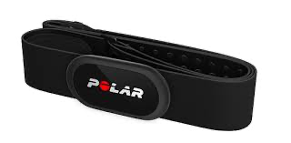
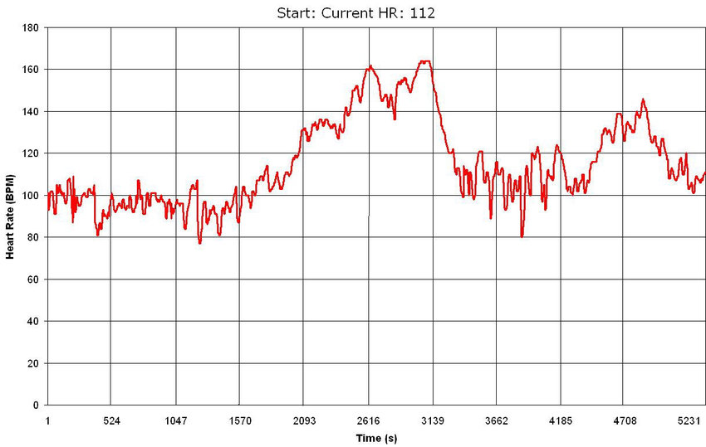
Lab program - The workshop
2-hours workshop where we will set up a fake clinical trial aimed at evaluating the cardiovascular tone in a cohort of healthy subjects using an experimental algorithm
The fastest 5 students to submit the right answer will get a +1 to the final evaluation.
1. Trial setup
2. Data collection using a wearable and an app
Together
3. Data preparation
4. Data analysis
Individually
5. Trial outcome

Slide 29

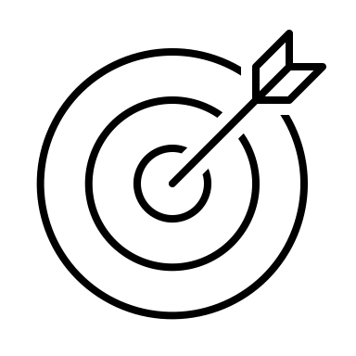
Prerequisites & End of class goals
Prerequisites
Basic:
Propension for programming
Preferable:
Object-oriented programming
Bonus: For the workshop
MATLAB
End of class goals
Learn how wearable devices communicates to the end-user
Design digital solutions to enhance healthcare and well-being
Develop a fully functioning mobile application

Slide 30
The exam
Dates of the written test
First round: 20 Jun 2024, 14:00 (Room Be+Ve)
Second round: 08 Jul 2024, 14:00 (Room Ae+Be)
Third round: 03 Sep 2024, 14:00 (Room De)
Fourth round: 31 Jan 2025, 14:00 (Room De)
Written test: Theory exam
15 closed questions
3 open questions
Duration: ~90 min
Max vote: 20/30
Project: Development of an application that integrates and elaborates data from a smartwatch. To be done in groups of 3 students.
Deadline for completion: The project code must be delivered by July 14th 2024, and no later than the day before the project discussion.
Discussion of the project (in group): day and time to be defined in dedicated
Window 1: from 01/07/2024 to 19/07/2024
Window 2: from 19/08/2024 to 20/09/2024
Duration of the discussion: 45 min (25 min presentation + 20 min Q&A)
Max vote: 12/30
Final mark: sum of the votes of the written test and the project.

Slide 31
Project: What’s the spirit here
The goal is learning “How to do SOMETHING using wearable devices”
What I DO expect from you
To use your imagination to create that SOMETHING
To learn to build something from scratch
To use code built by others
To work together
To use Google and StackOverflow
What I DO NOT expect from you
To create the new Google
To reinvent the wheel (copying others code is fine)
To create extra complicated UI with animations and stuff

Slide 32
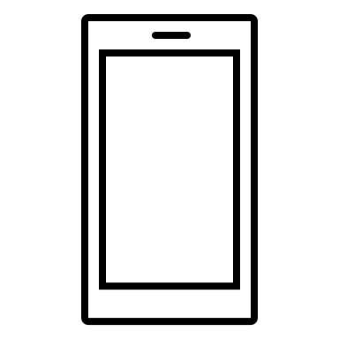




Project structure
The project consists of building an app for iOS or Android that collects user data from a wearable device through Web APIs, visualizes them, and does some tricks with them.
Core functionalities:
Correct app flow
User authentication and management
Data collection
Data visualization and presentation
Additional fuctionalities → It’s up to you! Some examples:
Run some analysis on data and provide suggestions to the user
Implement some literature algorithm
…

Slide 33
Grading
What are the grading criteria
Compliance to core functionalities
Originality of the additional feature
Quality of teamwork
How much these criteria matter?
Core functionalities: 50%
Additional app functionalities: 45%
Quality of teamwork: 5%

Slide 34


Choose your target
Your app must represent a solution for the current SDGs (Sustainable Development Goals) targets
SDG are 17 topics representing the current big challenges humanity must face and solve

Slide 35
Choose your target
These are the target you can choose from (see the elearning page for more details):
SDG 2: Target 2.2 (By 2030, end all forms of malnutrition, including achieving, by 2025, the internationally agreed targets on stunting and wasting in children under 5 years of age, and address the nutritional needs of adolescent girls, pregnant and lactating women and older persons) – max 4 groups
SDG 2: Target 2.3 (By 2030, double the agricultural productivity and incomes of small-scale food producers, in particular women, indigenous peoples, family farmers, pastoralists and fishers, including through secure and equal access to land, other productive resources and inputs, knowledge, financial services, markets and opportunities for value addition and non-farm employment) – max 4 groups
SDG 3: Target 3.4 (By 2030, reduce by one third premature mortality from non-communicable diseases through prevention and treatment and promote mental health and well-being) – max 8 groups
SDG 3: Target 3.5 (Strengthen the prevention and treatment of substance abuse, including narcotic drug abuse and harmful use of alcohol) – max 8 groups
SDG 4: Target 4.7 (By 2030, ensure that all learners acquire the knowledge and skills needed to promote sustainable development, including, among others, through education for sustainable development and sustainable lifestyles, human rights, gender equality, promotion of a culture of peace and non-violence, global citizenship and appreciation of cultural diversity and of culture’s contribution to sustainable development) – max 4 groups
SDG 8: Target 8.9 (By 2030, devise and implement policies to promote sustainable tourism that creates jobs and promotes local culture and products) – max 4 groups

Slide 36

Data source
Data that you will use are collected by me using a Fitbit Versa 2
Data are available starting from 09/02 and will be collected up to 30/11
The following data “types” are included(see mor details in the Appendix):
Calories
Distance
Exercise sessions
Heart rate
Resting heart rate (Estimated)
Sleep
Steps
Your project must use at least 1 type of data

Slide 37






How to get data - The IMPACT backend
HTTPS requests/responses
Get token (JWT) using credentials
(If credentials are ok) Receive token
Ask for specific data using token
(If request is ok) Receive data (JSON format)
https://impact.dei.unipd.it/bwthw/
Your app
You will be provided with credentials (different for each group) and learn how to get data in the next lessons (lab lesson 9 and 10)

Slide 38


Optional tutoring activities
Need help? They are here to cover your back with answers and optional tutoring activities
Calendar of the optional tutoring activities
Luca Cossu
luca.cossu@phd.unipd.it
Michele Atzeni
michele.atzeni@phd.unipd.it
Day | Time | Room | Topic
07/03/2024 | 10:30 - 12:30 | Ee | Tutoring 1: Exercises in Dart
14/03/2024 | 10:30 - 12:30 | Ee | Tutoring 2: Exercises in Dart
21/03/2024 | 10:30 - 12:30 | Ee | Tutoring 3: Sample App Presentation + Setup
11/04/2024 | 10:30 - 12:30 | Ee | Tutoring 4: UI + Navigation
18/04/2024 | 10:30 - 12:30 | Ee | Tutoring 5: State Management
02/05/2024 | 10:30 - 12:30 | Ee | Tutoring 6: SharedPreferences + Authentication
09/05/2024 | 10:30 - 12:30 | Ee | Tutoring 7: HTTP Data request
16/05/2024 | 10:30 - 12:30 | Ee | Tutoring 8: Algorithm
23/05/2024 | 10:30 - 12:30 | Ee | Tutoring 9: Wrapping up
28/05/2024 | 14:30 - 16:30 | Te | Tutoring 10: Bonus

Slide 39




Discord server
New
Join the Discord server to get in touch and ask questions
Link: https://discord.gg/j76A3D27bm

Slide 40
Appendix: Data source characteristics

Slide 41
Focus on data – Calories
Calories: a list with 1 data point exactly every minute
Fields meaning:
time: timestamp (hh:mm:ss format) of the calory entry
value: the calories spent during the last 1 minute (rest + active)
[
{
"time": "00:00:00",
"value": "1.29"
},
{
"time": "00:01:00",
"value": "1.29"
},
{
"time": "00:02:00",
"value": "1.29"
},
{
"time": "00:03:00",
"value": "1.55"
},
{
"time": "00:04:00",
"value": "1.29"
},
{
"time": "00:05:00",
"value": "1.29"
},
{
"time": "00:06:00",
"value": "1.29"
},
...
]

Slide 42
Focus on data – Distance
Distance: a list with 1 data point every minute or more depending on user’s movement
Fields meaning:
time: timestamp (hh:mm:ss format) of the distance entry
value: the distance travelled between the last timestamp and now (in cm)
[
{
"time": "00:03:00",
"value": "0"
},
{
"time": "00:50:00",
"value": "0"
},
{
"time": "01:28:00",
"value": "0"
},
{
"time": "01:32:00",
"value": "1440"
},
{
"time": "01:33:00",
"value": "3110"
},
{
"time": "01:34:00",
"value": "0"
},
{
"time": "01:53:00",
"value": "0"
},
{
"time": "03:09:00",
"value": "0"
},
...
]

Slide 43
Focus on data – Steps
Steps: a list with 1 data point every minute or more depending on user’s movement
Fields meaning:
time: timestamp (hh:mm:ss format) of the step entry
value: the number of steps done between the last timestamp and now
Note: there can be days without data
[
{
"time": "00:07:00",
"value": "0"
},
{
"time": "00:10:00",
"value": "0"
},
{
"time": "01:57:00",
"value": "0"
},
{
"time": "02:29:00",
"value": "0"
},
{
"time": "02:40:00",
"value": "0"
},
{
"time": "02:57:00",
"value": "11"
},
{
"time": "02:58:00",
"value": "18"
},
{
"time": "02:59:00",
"value": "0"
}, ...
]

Slide 44
Heart rate
Heart rate: a list with 1 data point every 5 seconds.
Fields meaning:
time: timestamp (hh:mm:ss format) of the heart rate entry
value: the heart rate at the current time (in bpm)
confidence: a number from 0 to 3 defining how much the reading is reliable (this problably depends on user movement, etc. You can ignore it)
Note: there can be missing values
[
{
"time": "03:10:19",
"value": 58,
"confidence": 1
},
{
"time": "03:10:24",
"value": 54,
"confidence": 3
},
{
"time": "03:10:29",
"value": 52,
"confidence": 3
},
{
"time": "03:10:44",
"value": 52,
"confidence": 3
},
{
"time": "03:10:54",
"value": 53,
"confidence": 3
},
{
"time": "03:11:09",
"value": 54,
"confidence": 3
},
{
"time": "03:11:19",
"value": 53,
"confidence": 3
}, ...
]

Slide 45
Resting heart rate
Resting heart rate: an entry per day.
Fields meaning:
time: timestamp (hh:mm:ss format) of the resting heart rate entry (always 00:00:00)
value: the estimated resting heart rate at the current time (in bpm)
error: the estimate error (in %) (Can be ignored)
Note: there can be days without data
{
"time": "00:00:00",
"value": 51.35,
"error": 17.86
}

Slide 46
Exercise
[
{
"activityName": "Corsa",
"averageHeartRate": 143,
"calories": 727,
"distance": 8.474117,
"distanceUnit": "Kilometer",
"duration": 3.548E+6,
"activeDuration": 3.214E+6,
"steps": 8604,
"logType": "tracker",
"heartRateZones": [
{
"name": "Fuori zona",
"min": 30,
"max": 110,
"minutes": 3,
"caloriesOut": 30.146219999999971
},
{
"name": "Grassi bruciati",
"min": 110,
"max": 137,
"minutes": 8,
"caloriesOut": 97.13782
},
{
"name": "Attivita aerobica",
"min": 137,
"max": 170,
"minutes": 48,
"caloriesOut": 659.73843
},
{
"name": "Picco",
"min": 170,
"max": 220,
"minutes": 0,
"caloriesOut": 0
}
],
"speed": 9.4981754822650917,
"vo2Max": {
"vo2Max": 48.77853
},
"elevationGain": 28.042,
"time": "11:22:43"
},
Exercise: a list with 1 entry for each recorded exercise session
Fields meaning:
activityName: the type of entry (“Corsa”: Run, “Bici”: bike, “Camminata”: Walk)
averageHeartRate: the average heart rate during the session
calories: the active calories spent during the session
distance: the distance covered during the session
distanceUnit: the unit of the “distance” field
duration: the total duration of the session (in ms)
activeDuration: the total active duration of the session (in ms)
steps: the total number of steps done during the session (if “Corsa” or ”Camminata”)
logType: how this record was logged (“tracker” or “auto_detected”)
heartRateZones: a list that summarizes the number of minutes and calories spent in specific heart rate ranges (from min to max)
speed: the average speed (in km/h)
vo2max: the estimated running VO2Max (only for “Corsa” activities)
elevationGain: the elevation gained during the session
time: the starting time of the session (format hh:mm:ss)
Note: different activity types can have (slightly) different fields
Note: there can be days without data
{
"activityName": "Bici",
"averageHeartRate": 150,
"calories": 3893,
"distance": 140.143695,
"distanceUnit": "Kilometer",
"duration": 2.0901E+7,
"activeDuration": 1.756E+7,
"logType": "tracker",
"heartRateZones": [
{
"name": "Fuori zona",
"min": 30,
"max": 110,
"minutes": 28,
"caloriesOut": 214.83527999999842
},
{
"name": "Grassi bruciati",
"min": 110,
"max": 136,
"minutes": 64,
"caloriesOut": 664.55027999999993
},
{
"name": "Attivita aerobica",
"min": 136,
"max": 170,
"minutes": 232,
"caloriesOut": 3167.1500100000012
},
{
"name": "Picco",
"min": 170,
"max": 220,
"minutes": 24,
"caloriesOut": 377.76059999999995
}
],
"speed": 28.734978587699313,
"elevationGain": 663.55,
"time": "11:03:54"
},...
]

Slide 47
Sleep
Sleep: a list with 1 entry for each sleep session
Fields meaning:
dateOfSleep: day associated to the sleep entry (MM-DD format)
startTime: the starting timestamp of the sleep (MM-DD hh:mm:ss format)
endTime: the ending timestamp of the sleep (MM-DD hh:mm:ss format)
duration: the duration of the sleep session (in ms)
minutesToFallAsleep: the number of minutes spent to fall asleep
minutesAsleep: the number of minutes asleep during the sleep entry
minutesAwake: the number of minutes awake during the sleep entry
minutesAfterWakeup: the number of minutes the user spent in bed after waking up
efficiency: the estimated sleep efficiency (from 0 to 100)
logType: how the entry was logged (always “auto_detected”)
mainSleep: a boolean indicating if the entry corresponds to the main sleep session
levels: a summary of the sleeping stages (deep/wake/light/rem/restless) during the sleep session
data: the stage profile of the sleep session. Each entry contains the starting timestamp, the level, and how much it lasted.
Note: there can be days without data
[
{
"dateOfSleep": "02-14",
"startTime": "02-13 22:44:00",
"endTime": "02-14 06:36:30",
"duration": 2.832E+7,
"minutesToFallAsleep": 0,
"minutesAsleep": 429,
"minutesAwake": 43,
"minutesAfterWakeup": 3,
"timeInBed": 472,
"efficiency": 96,
"logType": "auto_detected", ”mainSleep": true,
"levels": {
"summary": {
"deep": {
"count": 5,
"minutes": 106,
"thirtyDayAvgMinutes": 86
},
"wake": {
"count": 34,
"minutes": 43,
"thirtyDayAvgMinutes": 46
},
"light": {
"count": 28,
"minutes": 235,
"thirtyDayAvgMinutes": 281
},
"rem": {
"count": 11,
"minutes": 88,
"thirtyDayAvgMinutes": 101
}
},
"data": [
{
"dateTime": "02-13 22:44:00",
"level": "wake",
"seconds": 30
},
{
"dateTime": "02-13 22:44:30",
"level": "light",
"seconds": 150
},
{
"dateTime": "02-13 22:47:00",
"level": "deep",
"seconds": 1860
}, ... },
...
]

